Slide 1
北京大学微处理器研发中心
硕士工作汇报
BOOM Core
姓名 | 阳庆红
学号 | 1501214366
年级 | 2015级

Slide 2
主要内容
Introduction & Overview
Instruction Fetch
Unified Physical Register File
The Decode Stage
The Rename Stage
ROB & The Dispatch Stage
The Issue Unit
The Register File and Bypass
The Execute Pipeline
The Load/Store Unit
后期工作安排

Slide 3
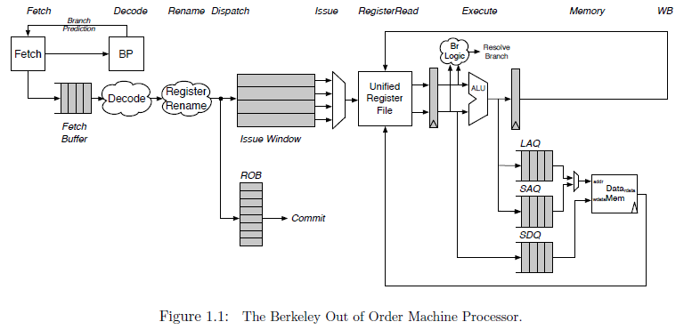
Introduction & Overview
A unified physical register file design
Superscalar、Out of Order、Six stages
Fetch, Decode/Rename/Dispatch, Issue/RegisterRead, Execute, Memory, and Writeback
Notes:
1. Commit occurs asynchronously
2.

Slide 4
主要内容
Introduction & Overview
Instruction Fetch
Unified Physical Register File
The Decode Stage
The Rename Stage
ROB & The Dispatch Stage
The Issue Unit
The Register File and Bypass
The Execute Pipeline
The Load/Store Unit
后期工作安排

Slide 5
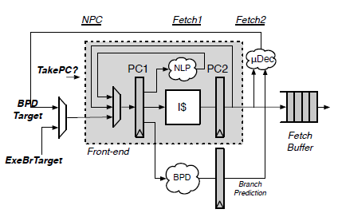
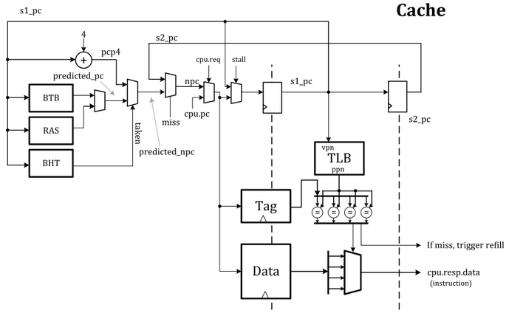
Instruction Fetch
Rocket Core’ Front-end
BOOM Fetch Unit
BOOM instantiates the Rocket core's Front-end
If a misprediction is detected, or BOOM's own predictor wants to redirect the pipeline in a difference direction, a request is sent to the Front-End and it begins fetching along a new instruction path

Slide 6
Instruction Fetch
Rocket Core’ Front-end
BOOM Fetch Unit
Since superscalar fetch is supported, the Front-end returns a fetch packet of instructions
The I-Cache is a virtually indexed, physically tagged set-associative cache

Slide 7
主要内容
Introduction & Overview
Instruction Fetch
Unified Physical Register File
The Decode Stage
The Rename Stage
ROB & The Dispatch Stage
The Issue Unit
The Register File and Bypass
The Execute Pipeline
The Load/Store Unit
后期工作安排

Slide 8
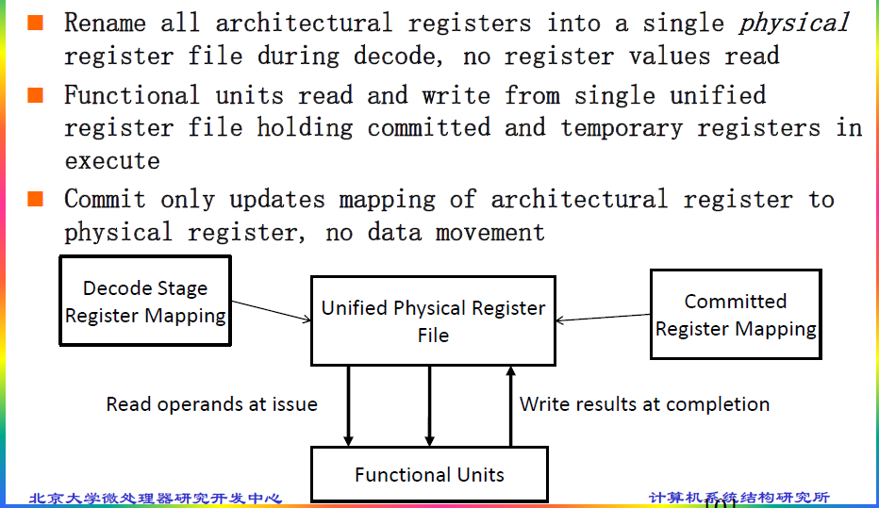
Unified Physical Register File

Slide 9
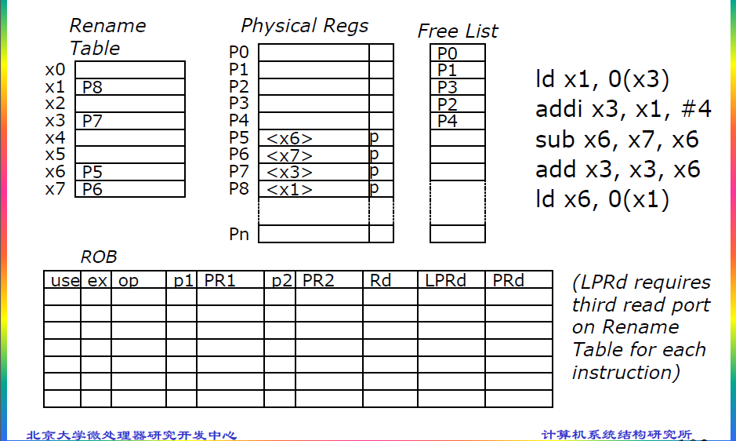
Unified Physical Register File

Slide 10
主要内容
Introduction & Overview
Instruction Fetch
Unified Physical Register File
The Decode Stage
The Rename Stage
ROB & The Dispatch Stage
The Issue Unit
The Register File and Bypass
The Execute Pipeline
The Load/Store Unit
后期工作安排

Slide 11
The Decode Stage
The decode stage takes instructions from the fetch buffer, decodes them, and allocates the necessary resources as required by each instruction. The decode stage will stall as needed if not all resources are available.

Slide 12
主要内容
Introduction & Overview
Instruction Fetch
Unified Physical Register File
The Decode Stage
The Rename Stage
ROB & The Dispatch Stage
The Issue Unit
The Register File and Bypass
The Execute Pipeline
The Load/Store Unit
后期工作安排

Slide 13
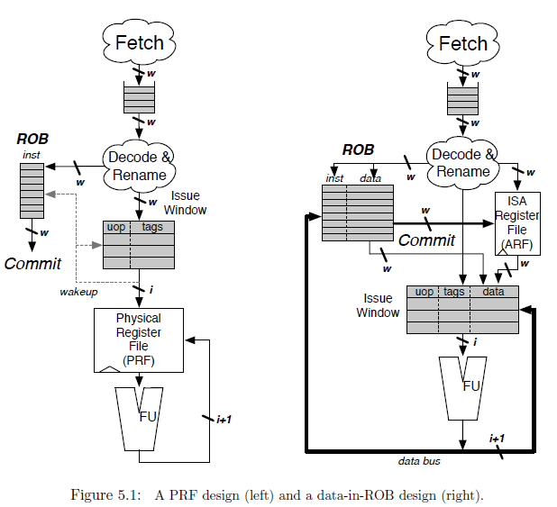
The Rename Stage
WAW & WAR
Explicit & Implicit
Committed & Speculative
Branch
Exception
Notes:
register renaming eliminates write-after-write (WAW) and write-after-read (WAR) hazards, which are artifacts introduced by a) only having a limited number of ISA registers to use as specifiers and b) loops, which by their very nature will use the same register specifiers on every loop iteration.
As instructions are renamed, their register specifiers are explicitly updated to point to physical registers located in the physical register file
A physical register file, containing many more registers than the ISA dictates, holds both the committed architectural register state and speculative register state.
This is in contrast to an "implicit renaming" or "data-in-ROB" out-of-order core design. The Architectural Register File only holds the committed register state, while the ROB holds the speculative write-back data
Each branch gets its own copy of the rename map table. On a branch mispredict, the map table can be reset from the mispredic branch's copy of the map table.
Exception： 两种策略（一步到位、回滚）

Slide 14
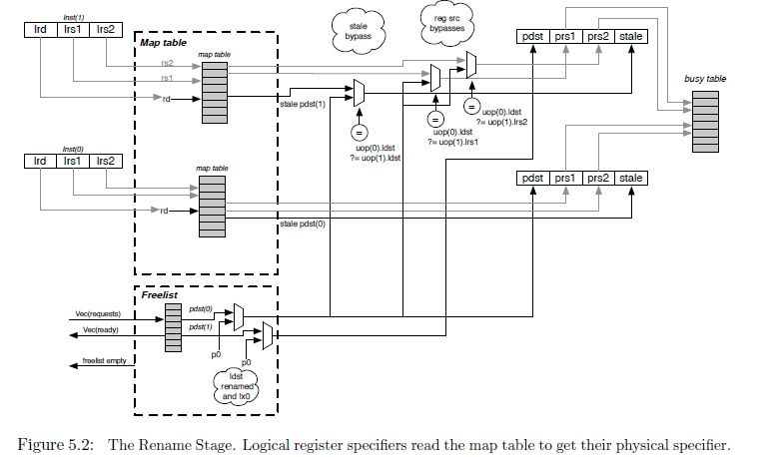
The Rename Stage
Notes:
1. The Busy Table tracks the readiness status of each physical register. If all physical operands are ready, the instruction will be ready to be issued.
2. The Free List is implemented as a bit-vector. A priority decoder can then be used to find the first free register. BOOM uses a cascading priority decoder to allocate multiple registers per cycle
3. Free List support for Branch：the Free List also sets aside a new "Allocation List", initialized to zero. As new physical registers are allocated, the Allocation List for each branch is updated to track all of the physical registers that have been allocated after the branch. If a misspeculation occurs, its Allocation List is added back to the Free List by OR'ing the branch's Allocation List with the Free List

Slide 15
主要内容
Introduction & Overview
Instruction Fetch
Unified Physical Register File
The Decode Stage
The Rename Stage
ROB & The Dispatch Stage
The Issue Unit
The Register File and Bypass
The Execute Pipeline
The Load/Store Unit
后期工作安排

Slide 16
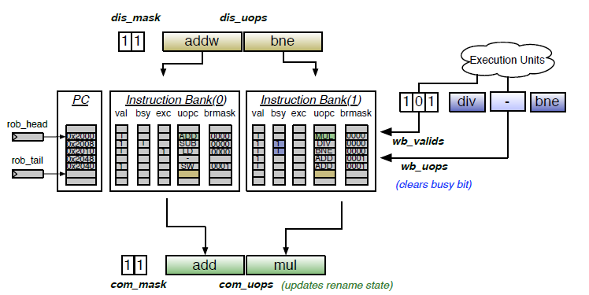
ROB & The Dispatch Stage
ROB Organization
circular buffer、w banks
valid/busy/exception/branch mask/uopc/lrd/stale pdst
floating-point status updates/other miscellaneous data
Figure 6.1: The Reorder Buffer for a two-wide BOOM with three-issue
Notes:
1. 跟踪流水线上所有指令、按序执行的假象
2. Dispatch：ROB & Issue Window、marked busy，如果指令Completed就会被标记为not busy
3. 若位于ROB head的指令发生Exception，ROB可以选择回滚的方式回退机器状态（table mapping 和 free list），整个流水线会被flush
4. W 是同时Dispatch或提交的指令数目
5. 每次被dispatch的指令必须是地址连续的，并且是对齐的，这样子多个bank能共享PC的高位域，PC的低位域用来索引Bank。所以，branch指令可能带来Bubble
6. other miscellaneous（五花八门） data (e.g., helpful for statistic（统计的） tracking)
7. 当store指令被提交时，该指令被发送到memory，对于多个stores同时被提交，LSU会被告知有多少个stores被提交，LSU将会依次提交stores到memory。

Slide 17
主要内容
Introduction & Overview
Instruction Fetch
Unified Physical Register File
The Decode Stage
The Rename Stage
ROB & The Dispatch Stage
The Issue Unit
The Register File and Bypass
The Execute Pipeline
The Load/Store Unit
后期工作安排

Slide 18
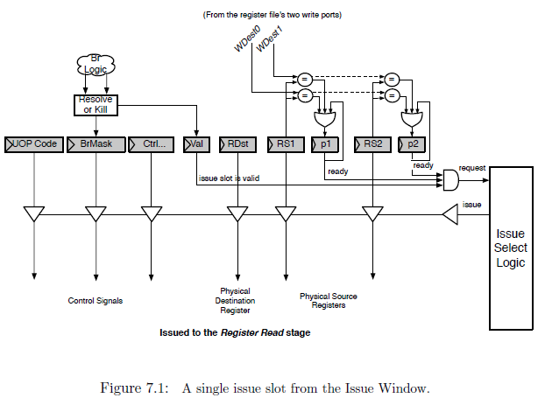
The Issue Slot
简单介绍~~~

Slide 19
主要内容
Introduction & Overview
Instruction Fetch
Unified Physical Register File
The Decode Stage
The Rename Stage
ROB & The Dispatch Stage
The Issue Unit
The Register File and Bypass
The Execute Pipeline
The Load/Store Unit
后期工作安排

Slide 20
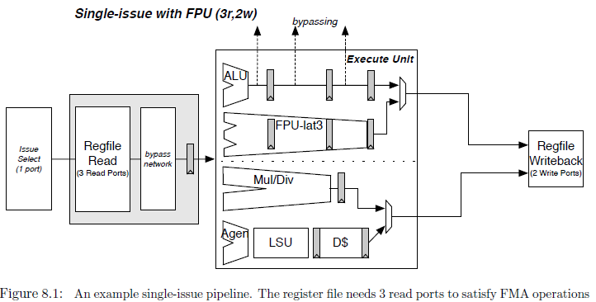
The Register File and Bypass
简单介绍~~~

Slide 21
主要内容
Introduction & Overview
Instruction Fetch
Unified Physical Register File
The Decode Stage
The Rename Stage
ROB & The Dispatch Stage
The Issue Unit
The Register File and Bypass
The Execute Pipeline
The Load/Store Unit
后期工作安排

Slide 22
The Execute Pipeline

Slide 23
主要内容
Introduction & Overview
Instruction Fetch
Unified Physical Register File
The Decode Stage
The Rename Stage
ROB & The Dispatch Stage
The Issue Unit
The Register File and Bypass
The Execute Pipeline
The Load/Store Unit
后期工作安排

Slide 24
The Load/Store Unit

Slide 25
主要内容
Introduction & Overview
Instruction Fetch
Unified Physical Register File
The Decode Stage
The Rename Stage
ROB & The Dispatch Stage
The Issue Unit
The Register File and Bypass
The Execute Pipeline
The Load/Store Unit
后期工作安排

Slide 26
后期工作安排
 | 任务 | 人数 | 文档章节 | 代码文件（.scala) | 代码行数
按序部分 | Instruction Fetch | 1 | 第二章（2页） | fetch | 253+
 | Branch Prediction | 2 | 第三章（14页） | brpredictor/bpd_pipeline/2bc-table/simplegshare/gshare/gskew/tage/Tage-csr/tage-table/tage-tagmemory/tage-ubits | 3461
 | Decode & Rename | 1 | 第四/五章（5页） | decode/fudecode/microop/rename | 1889
 | ROB & Dispatch | 1 | 第六章（4页） | rob | 1085
乱序部分 | Issue Unit | 1 | 第七章（3页） | issue/issue_slot/issue_ageordered/issue_unordered | 668
 | Register File & Bypass Network | 1 | 第八章（2页） | regfile/registerread | 304
 | Execute Pipeline | 2 | 第九章（8页） | execute/execution_units/functional_unit/imul | 1679
 | LSU & Dcache Shim | 2 | 第十章（5页） | lsu/dcacheshim | 1757

Slide 27
后期工作安排（探讨）
阅读文档和熟悉代码，了解Boom的整体架构，重点掌握各位负责的子模块的功能和对外连接情况。（1周）
阅读文档和代码，探索各子模块的设计方案（4周）
书写详细设计文档（2周）

Slide 28
谢谢！

